Slide 1
Modern Dataplatform Demo
Guido Schmutz

Slide 2

Platys – Trivadis Platform in a Box
Platy fish are quite common among freshwater aquarists. They’re beautiful, low-maintenance, quite fun to observe and ideal for beginners.
AUTOMATED
Platys offers an automated way to provision a modern Data Platform. All services are pre-configured with sensible defaults and can be combined as needed.
COST EFFICIENT
Platys is free to use and open source. It provides us and a customer a vehicle to experiment with a set of components without having to invest in infrastructure engineering.
“A delivery accelerator that minimises efforts
and time required for setting up a modern Data Platform
to be used for Proof-of-Concepts (PoC) projects as well as trainings by providing a modular, extensible and configurable set of container-based services ready to be used."
EASY TO EXTEND AND EXPAND
New services can be added to Platys with minimal effort, All components available as a Docker image are a first-class candidate to be supported by Platys.
RUNS ON PREM AND IN CLOUD
A Platys-based Data Platform can run locally on a developer notebook or on a virtual machine in a data center or in the cloud. It can be provisioned without the need for an infrastructure specialist.
LIGHTWEIGHT
A complex environment can easily run on a single machine with all services available to be downloaded from the internet. This allows for a very lightweight transportation to another environment.
FUTURE PROOF
Such a Data Platform acts as a blueprint for a future production setup and can be transformed and ported to a production ready infrastructure with minimal effort.

Slide 3
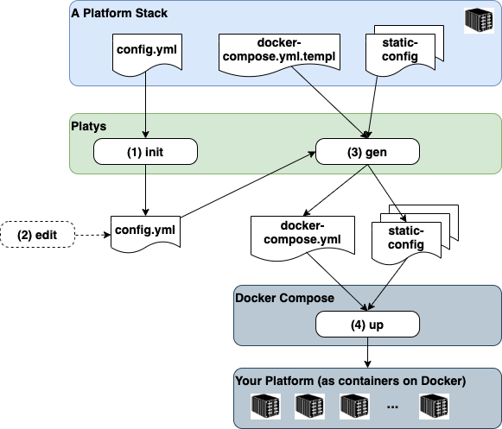
Platys – Trivadis Platform in a Box
How does it work?
Initialize a new platform project
Select and configure the required set of services by editing a config file
Run the generator producing all necessary artefacts of the platform
Start the platform by running docker
How has it been used?
Effort for provisioning a platform stays constant
Difference lays in how long the platform is used
One-Time
Consultancy
Technology
Training
2 – 5 days
Workshop
PoC/PoV
Project
platys
platys
platys
platys
usage
usage
usage
usage

Slide 4



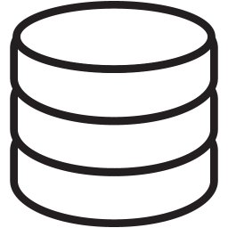


Modern Architecture
Hadoop Clusterd
Data Warehouse
Data Source
Hadoop Cluster
Cluster Infrastructure
SQL Export
COTS
App
File Import / SQL Import
Refined
Legacy
App
Storage
Results
BI Tools
SQL
Replay
Change Data
Capture
Raw
Parallel Processing
Data Flow
Streaming Data Source
Storage
Search
Event Stream
Event Broker
Big Data Batch Analytics
Search / Explore
Mobile
Apps
Event Stream
{ }
Edge Node
Search
IoT Data
Stream
Processor
State
Data Flow
API
Event Broker
Enterprise Apps
Location
Streaming Analytics
Service
{ }
{ }
Service
Social
Storage
API
Logic
Microservice
State
API
Weather
Rules
Event Stream
Modern Applications

Slide 5





Live Demo – Streaming Data Ingestion
Data Source
Customer
Event Broker
Event
Stream
Data Flow
Event
Stream
Product
Salesorder

Slide 6
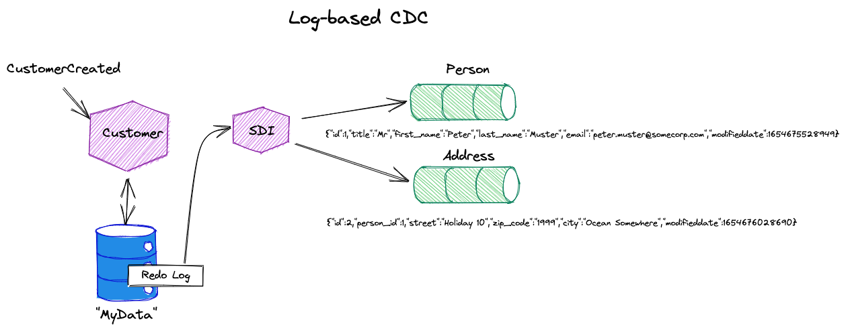
Log-based CDC

Slide 7
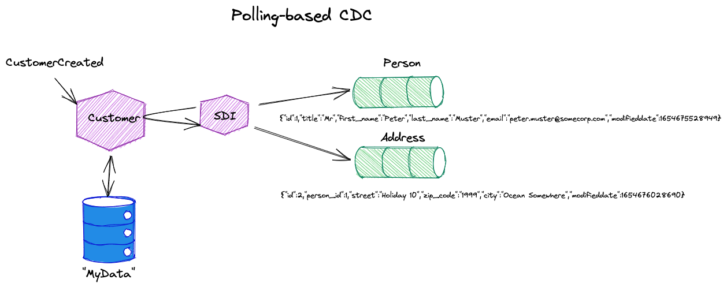
Polling (Query)-based CDC

Slide 8
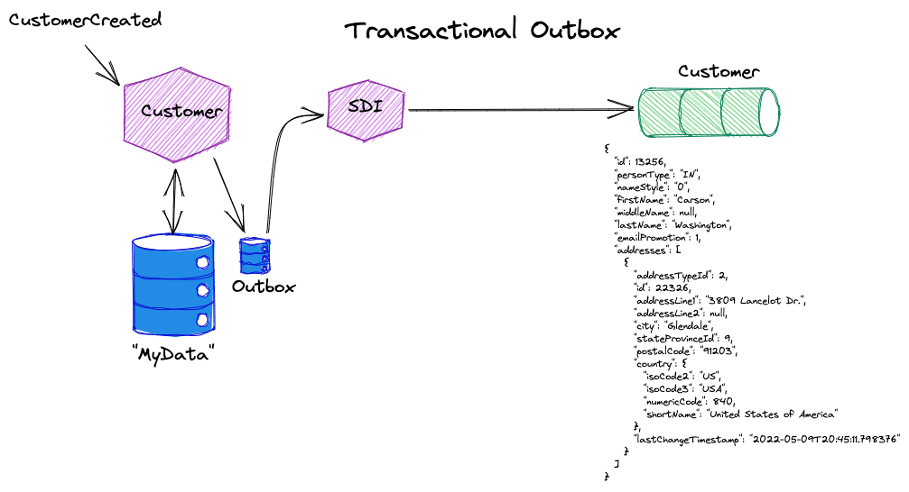
Transactional Outbox

Slide 9
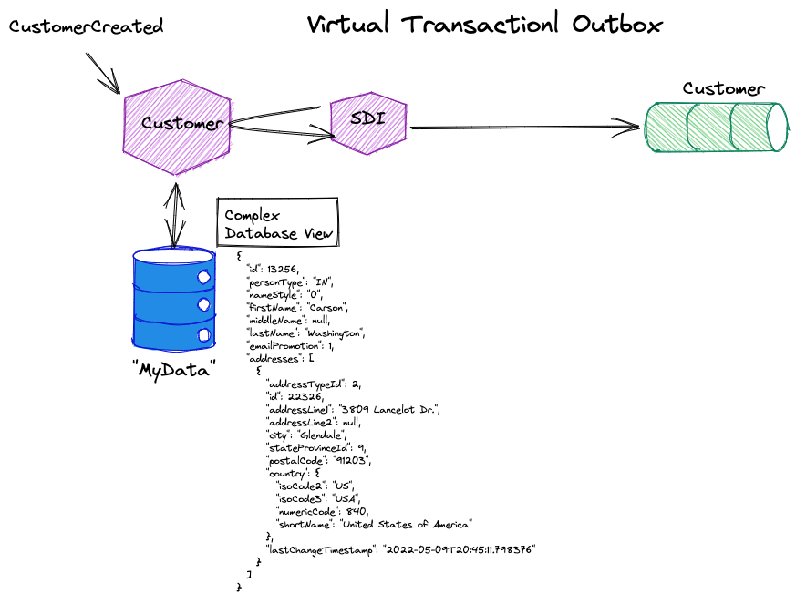
Virtual Transactional Outbox

Slide 10


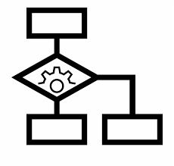


Live Demo - Stream Data Processing
Consumer
Data Source
Bi Tool
Customer
Event Broker
Event
Stream
Data Flow
Event
Stream
Data Science Workbench
Product
Event
Stream
Stream Processing Cluster
Salesorder
Event
Stream
Dashboard
Stream
Processor
Rules
Engine
Model /
State

Slide 11
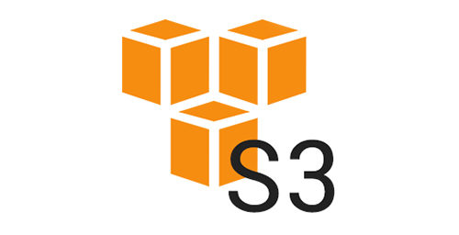

Live Demo – Store Raw Data
Hadoop Clusterd
Consumer
Hadoop Cluster
Big Data Platform
Data Source
Bi Tool
Customer
Event Broker
Bulk Data Flow
Data Flow
Bulk Data Flow
Event
Stream
Data Flow
Event
Stream
Raw
Data Science Workbench
Storage
Product
Event
Stream
Stream Processing Cluster
Salesorder
Event
Stream
Dashboard
Stream
Processor
Rules
Engine
Model /
State

Slide 12




Live Demo – Big Data Processing
Hadoop Clusterd
Consumer
Hadoop Cluster
Big Data Platform
Data Source
Refined /
Usage Opt
Query
Engine
SQL / Search
Event Broker
Bulk Data Flow
Bulk Data Flow
Storage
Customer
Data Flow
“Native” Raw
Event
Stream
Data Flow
Event
Stream
Raw
Data Science Workbench
Parallel Processing
Storage
Product
Event
Stream
Stream Processing Cluster
Salesorder
Event
Stream
Stream
Processor
Rules
Engine
Model /
State

Slide 13

Live Demo – Access Results using SQL
Hadoop Clusterd
Consumer
Hadoop Cluster
Big Data Platform
Data Source
Refined /
Usage Opt
Query
Engine
SQL / Search
Bi Tool
Event Broker
Bulk Data Flow
Bulk Data Flow
Storage
Customer
Data Flow
“Native” Raw
Event
Stream
Data Flow
Event
Stream
Raw
Data Science Workbench
Parallel Processing
Storage
Product
Stream Processing Cluster
Salesorder
Event
Stream
Stream
Processor
Rules
Engine
Model /
State

Slide 14
Thank You

